Slide 1
Natty Parks - A College Kids Guide to Software Engineering
By Adam Lynch, Chris Good, Lily Thongdygnalat, David Guare, Seth Vinson, Matt Muldoon, Chan Staples
Notes:
Identifying the Problem. What are the requirements and what does our client want? Organization Process Task Distribution Front-End Web Development Team Ideal Layout Progress Examples of what has been done What is left to be done Back-end Team Discusses how they will integreate the homepage into a working server
Game Development Team Discusses how they plan to create the video game and how they will enhance the experience of park vistors and their time at the parks
Discuss any problems or issues that we had or still have and solution we have explored For example, unfamiliar with html web designing. Gained knowledge of html and css and bootstrap to help accelerate website design in order to focus on more difficult task.

Slide 2
Project Requirements
Website with interactive game, a donation system, a ticketing system, and integration with social media.
Links to separate pages for all national and state parks

Slide 3
Back-End Requirements
Hosted on AWS
Server hosted on EC2 instance
Other info stored in ElasticSearch cluster
Site secured with SSL/TLS certificates

Slide 4
Home Page
Links to :
list of parks
interactive game
donation page for public and private parties
ticket based support page
National Parks’ Facebook, Twitter, Instagram, Snapchat, etc,
log in or create account

Slide 5
User Profile
User has profile page
Profile keeps track of user submissions and support tickets
Profile Picture
Notes:
Each user shall have a profile page, which shall be linked to alongside every submission they make on the website (reviews, images, support tickets, etc.)

Slide 6
User Roles: System Administrator
Edit any viewable content on website
Moderate posts by users and moderators
Access backend information, user database information, website data information
Access & rollback website backups & snapshots

Slide 7
User Roles: System Moderators
Moderate park pages & user submissions
Respond and remove user posts
Change publicly viewable information for users
Manually reset user passwords
Update blacklisted words/phrases
Ban/Unban users

Slide 8
User Roles: System Editor
Write & edit park information
Respond to park reviews
Approve user submissions about parks

Slide 9
User Roles: Park Moderators & Park Editors
Park Moderators:
Moderate & edit information & posts to their assigned park only
Remove user posts & images
Park Editors:
Write & edit park information for their assigned park only
Respond to park reviews
Approve user image & description posts
Notes:
Park Moderators - can’t remove reviews

Slide 10
User Roles: User
Post images, descriptions, reviews of park
Update information
Request to change username
Reset password
Edit own posts and reviews
Delete own posts, reviews, images

Slide 11
List of Parks Page
Organized list of parks by state, alphabet, location
Official picture as icon for park and link to its page
Each park has one administrative user.

Slide 12
Individual Park Pages
Each page has following sections:
Pictures of park
Description of park
Notable landmarks/traits
Lodging/vacation details
Link to images, reviews, descriptions from users about park

Slide 13
Donations
Payment will be processed by third party
Donator will enter name, company, email, amount in USD
Donator will choose payment option of PayPal or credit card
Donator will receive confirmation email once payment is complete

Slide 14
Submission of images, descriptions, reviews by Users
User has option to submit either anonymously or as a user
User selects the park they wish to submit
User has option to submit more than one image, review, description
After submission of information, user is taken to park page

Slide 15
Ticket Support Services
User logins to submit a support ticket
User selects park to submit a ticket for
User selects topic for ticket (vandalism, littering, natural disaster, problem with facilities, other)

Slide 16
Game
User logins to play game
Game keeps track of parks user has visited
User must scan QR code to confirm visitation to park
Game validates that the user is not a robot
Game grants points to user for visiting parks, visiting multiple places in parks, and submitting images, reviews, and descriptions of parks
Game has option to report a bug

Slide 17
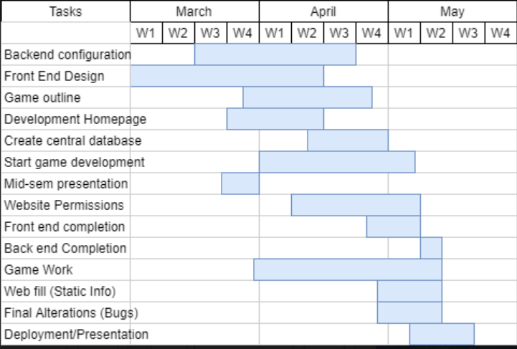
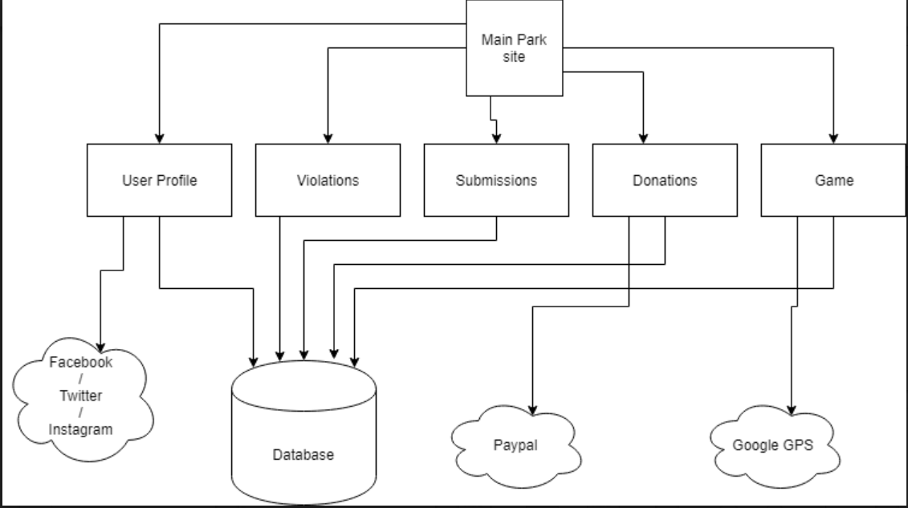
Diagrams
Gantt Chart Interface Spec ^
←

Slide 18
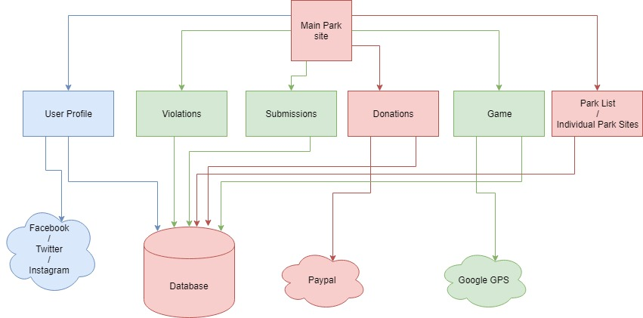
Regression Testing Model (Prioritization Method)
Order of Importance:
Red
Blue
Green

Slide 19
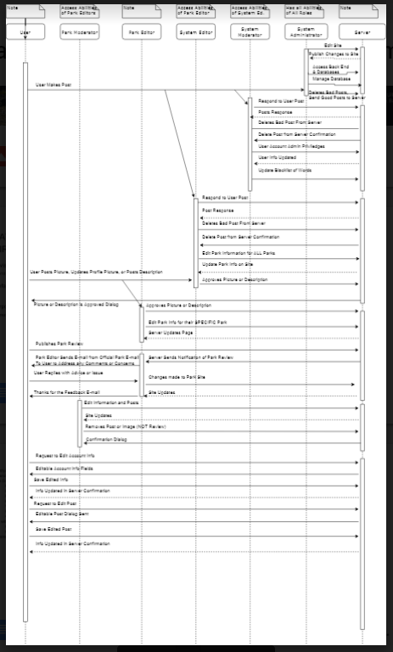
Sequence Diagram →

Slide 20
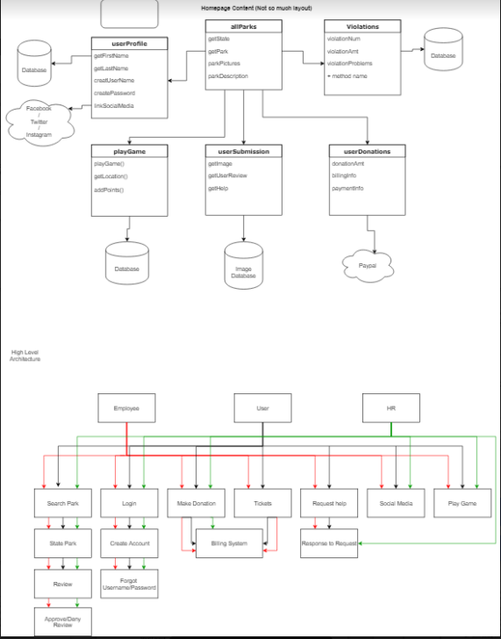
Home page content →
HLA Diagram →

Slide 21
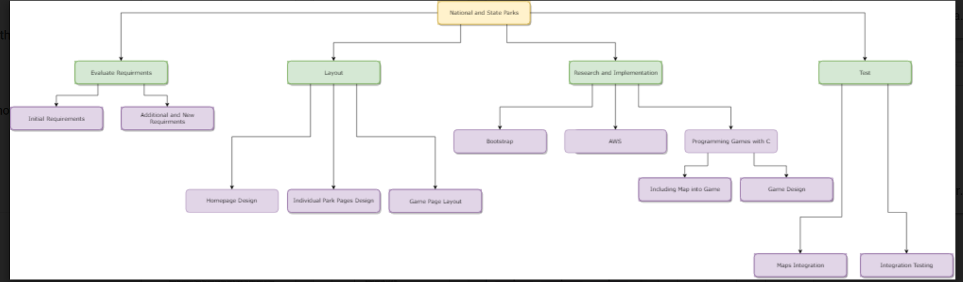

Slide 22
Web Development Update
Languages used include HTML and CSS
Currently testing out Bootstrap, which is open Source tool-kit that assist in the front-end development with HTML, CSS and JS.
In Progress..
Homepage 1 and 2
Two drastically different designs.
Homepage 2 implements Bootstrap, while homepage 1 does not.
Eventually, one design will determine the style of all pages.
“Create An Account” web page

Slide 23
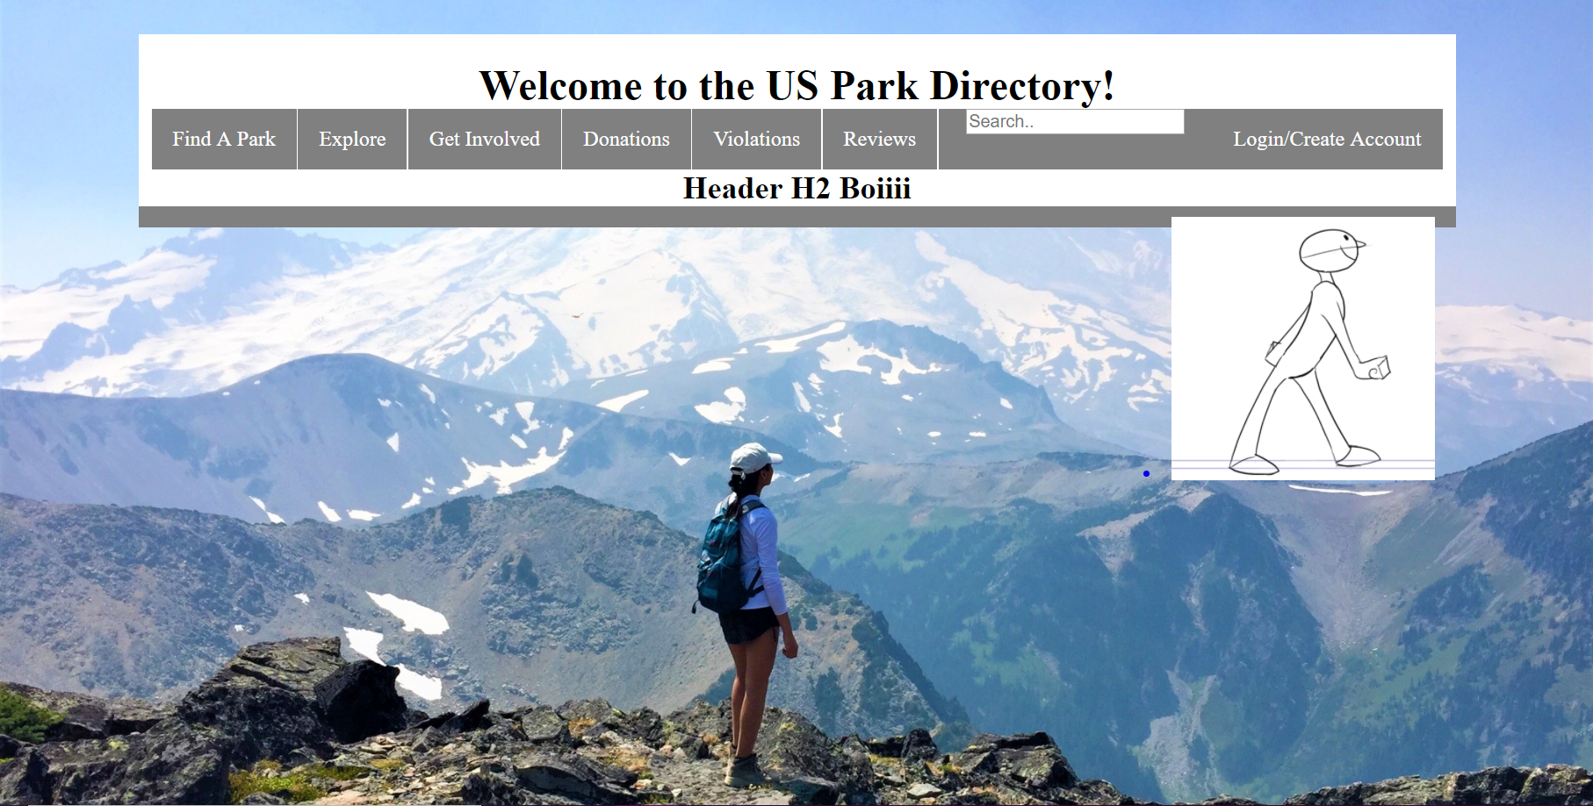
Website Homepage Version 1

Slide 24
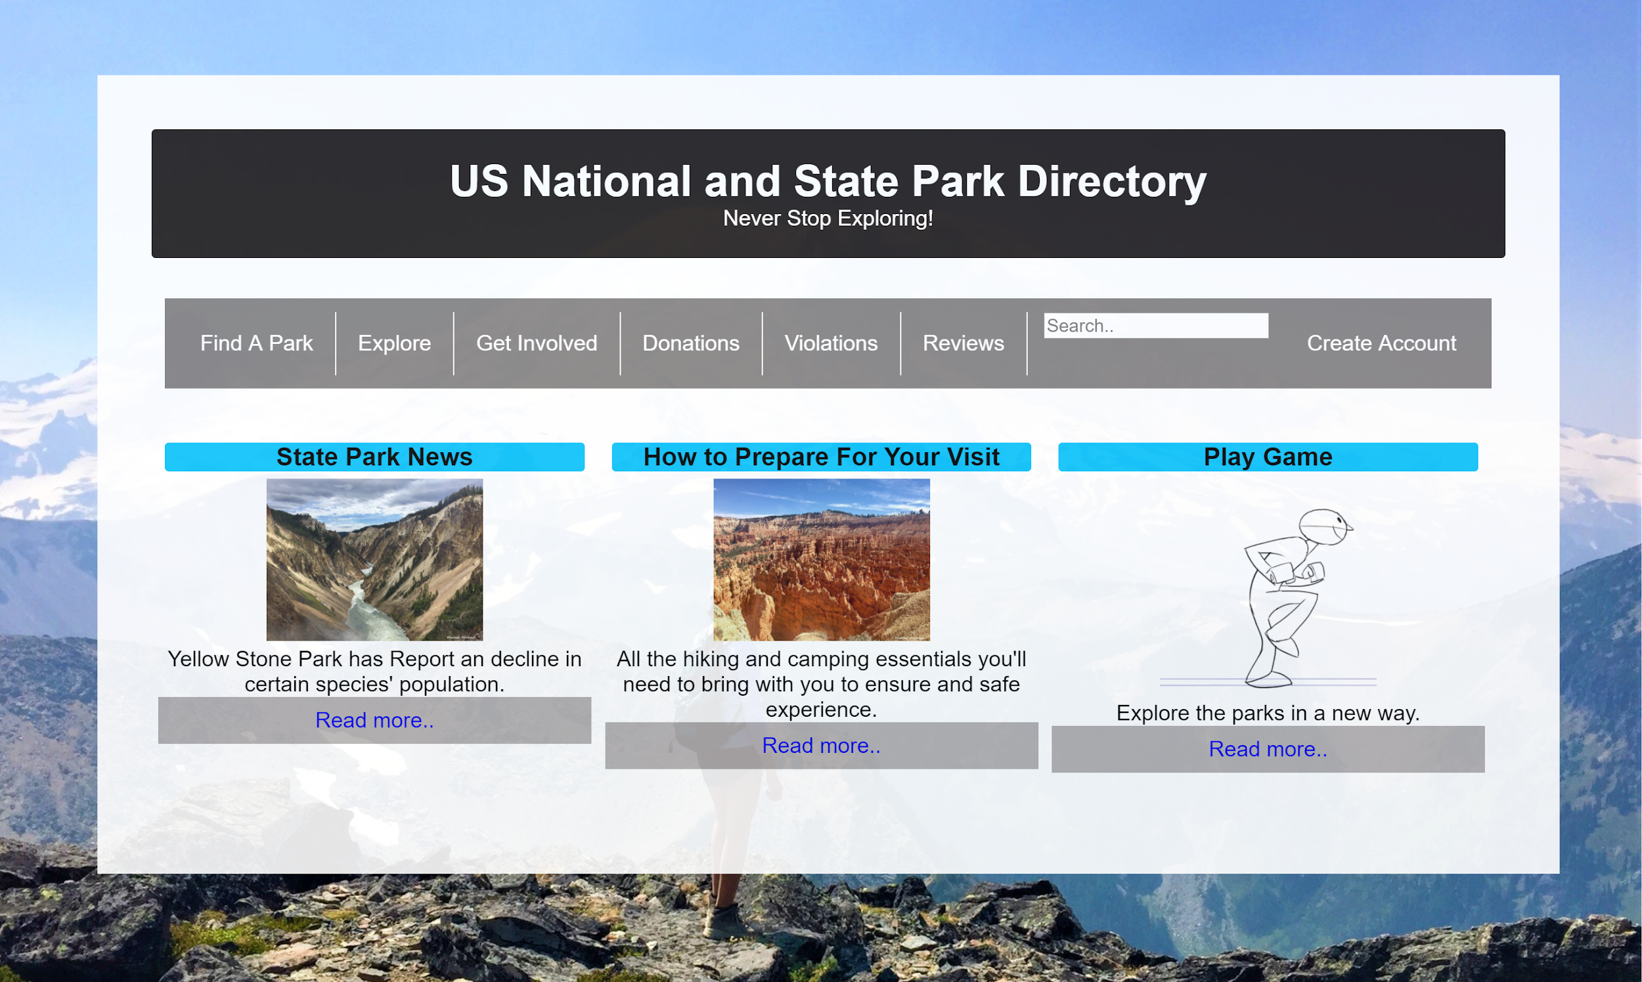
Website Homepage Version 1.2
Notes:
Homepage #1 was created out of scratch by our web development team.

Slide 25
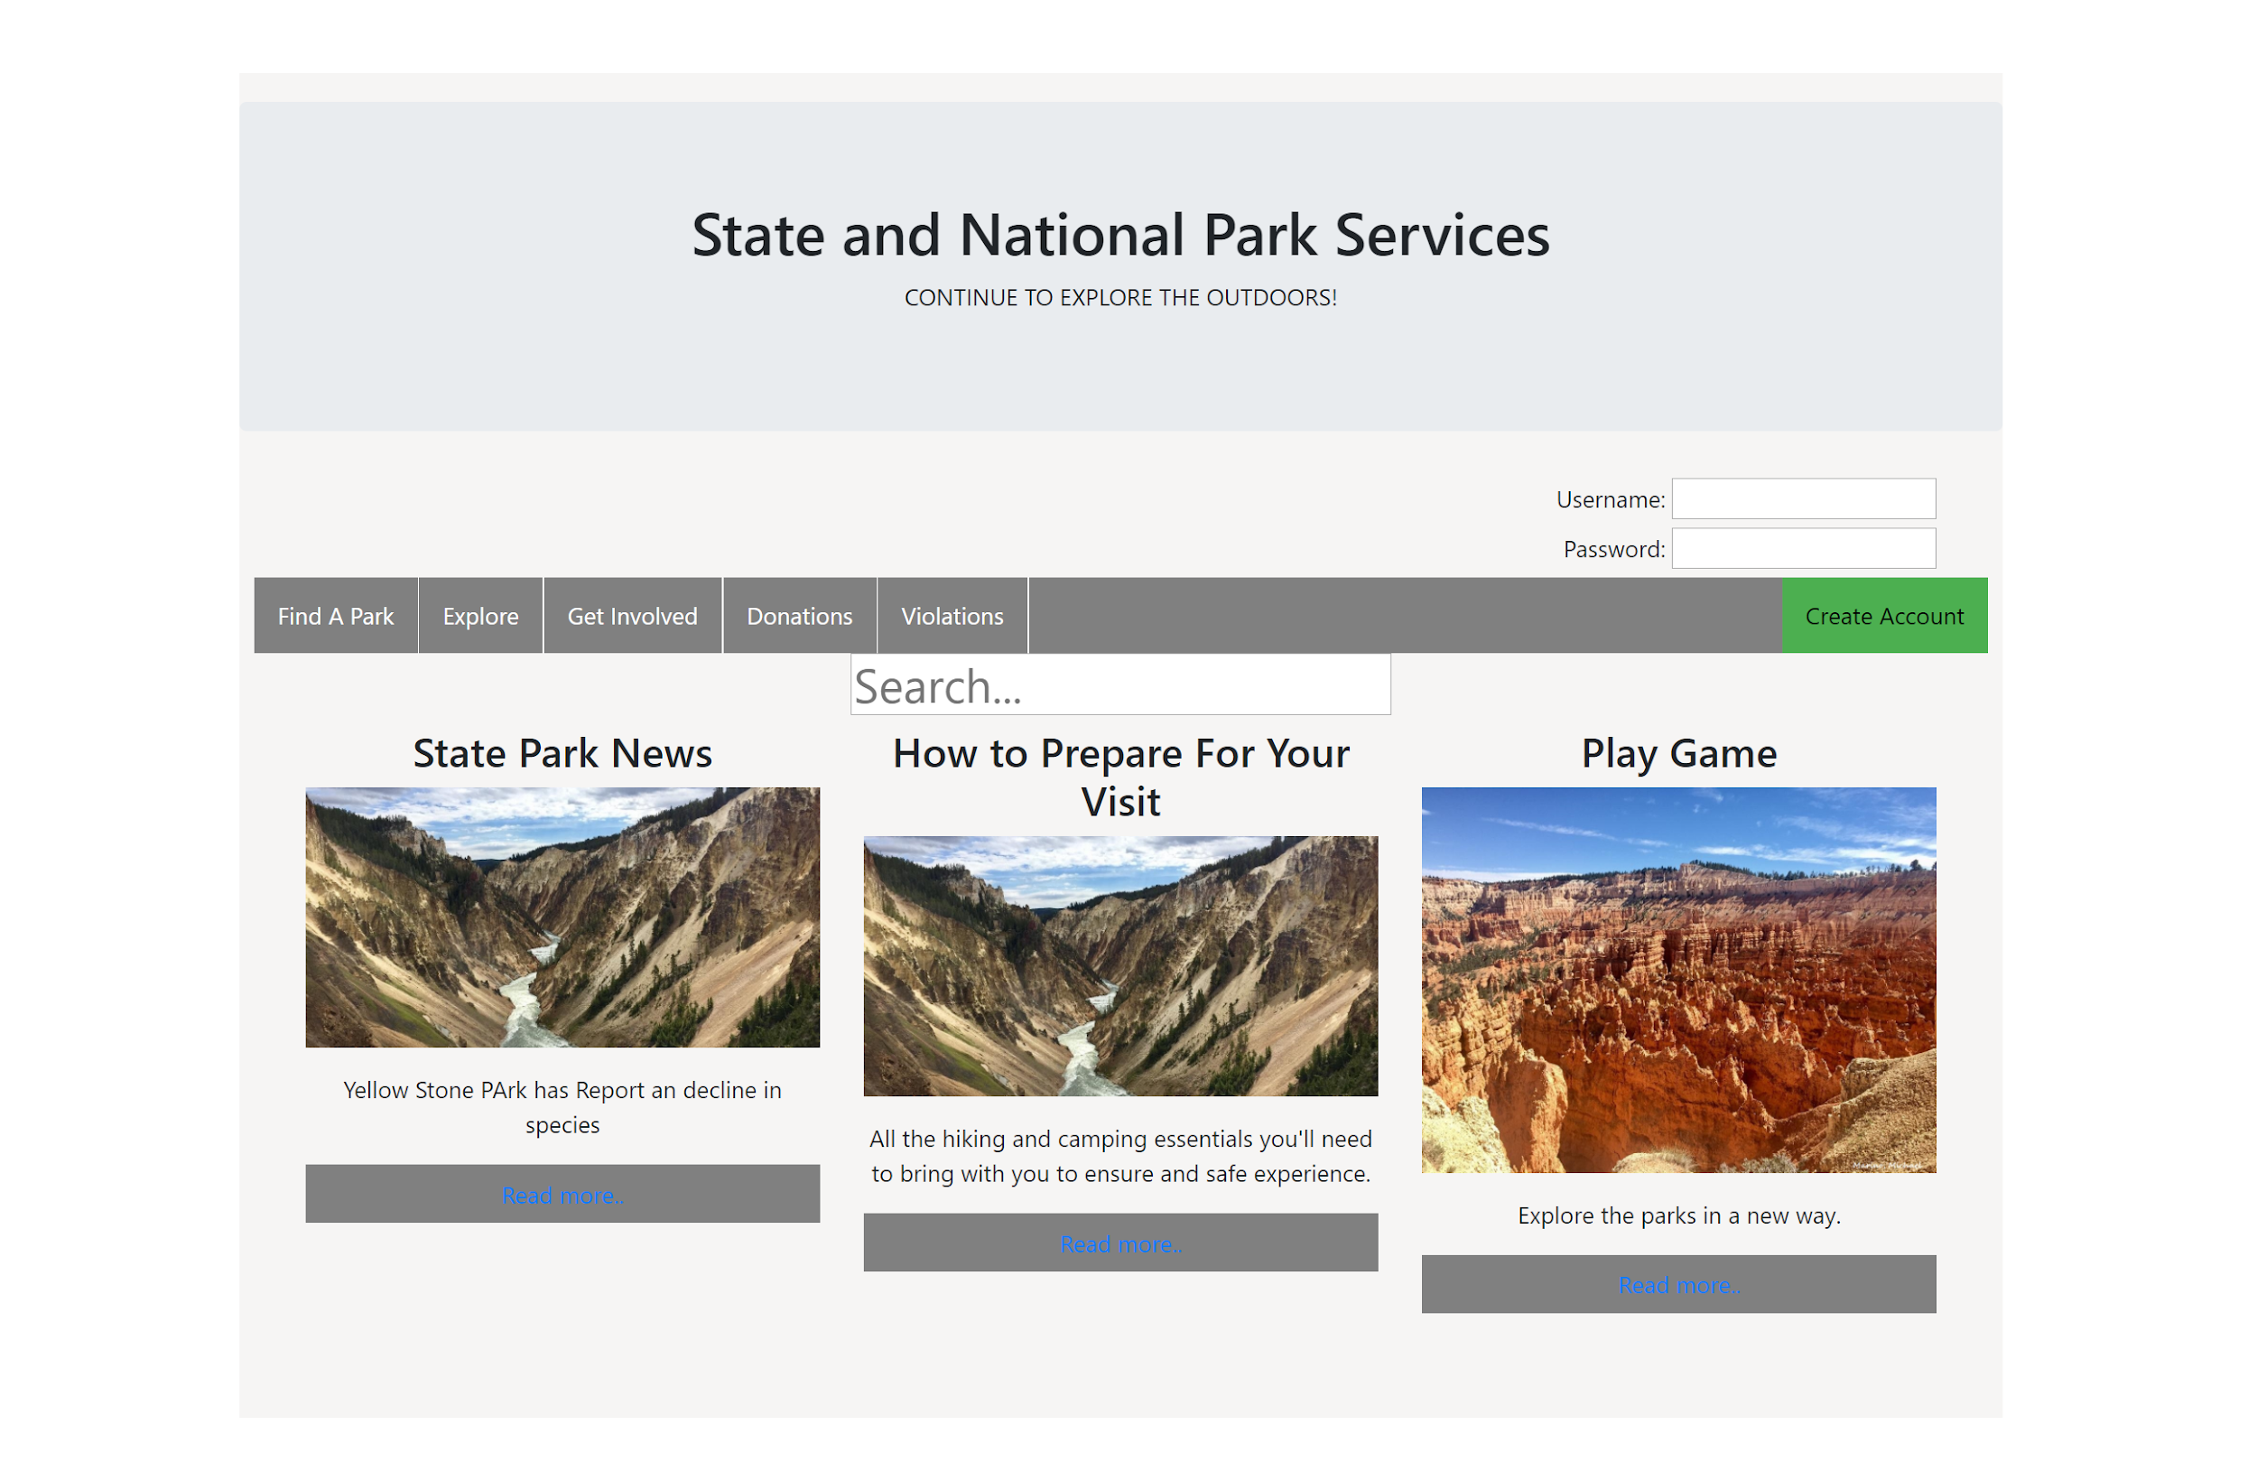
Website Homepage Version 2

Slide 26
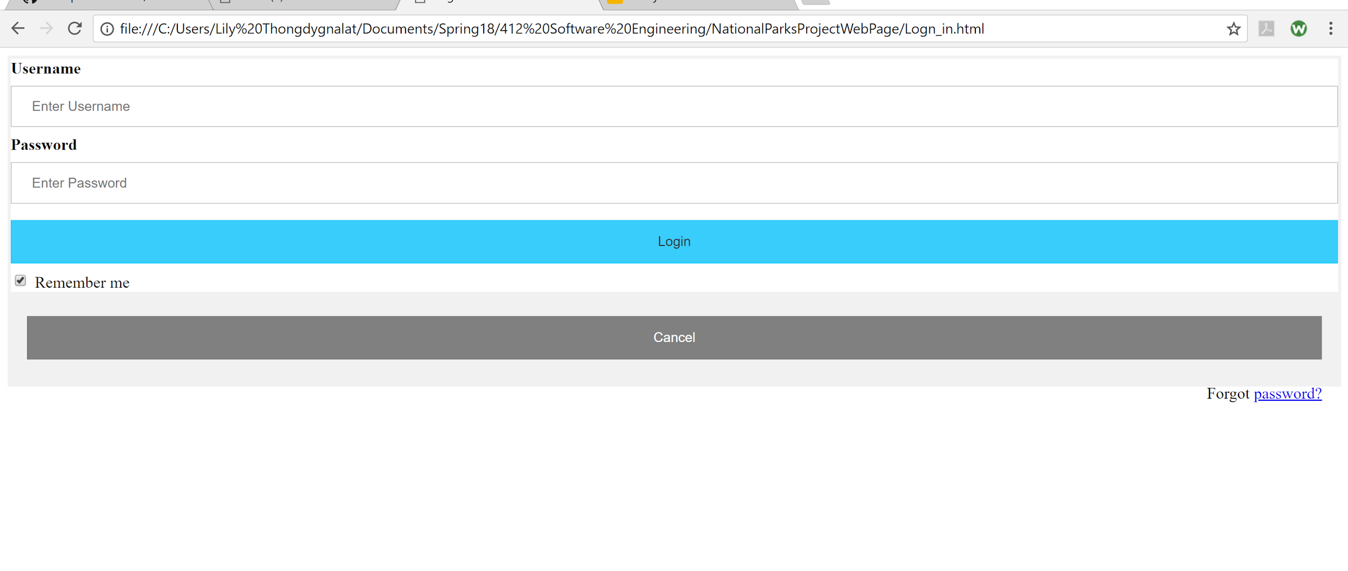
Create an Account and Login Page

Slide 27
Web Development Update(continue..)
After the completion of the pages, the Web Development Team will work on the remaining pages.
As each page is created, they are tested to ensure that they are linked correctly.

Slide 28
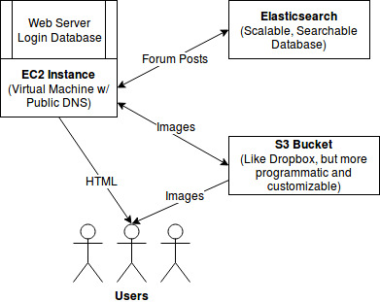
Back-End
Implemented:
EC2 instance, S3 Bucket, Elasticsearch Cluster
Set up basic, static website
Server pulls from Github repo periodically, easy to stay updated
To-Do:
Set up a better web server for dynamic HTML
Set up HTTPS so we can begin with payment processing
Finish login database and Elasticsearch storage

Slide 29
Natty Parks Go
Concept: Make a game similar to that of Pokemon Go
Mechanics:
GPS location services used to track users location and for different animals to spawn around them
QR Codes - used as a way to unlock new animals depending on which park the user is currently at
Home park - virtual park based on their choice of 3 - 4 different parks within their state
Can be customized slightly
Most customization comes from the different animals they collect. These animals will inhabit their park
Friend system where users can add their friends accounts
This allows their friends to visit their home park
Collecting animals - users will have to befriend animals by giving them the correct kind of food that they would naturally eat in the wild

Slide 30
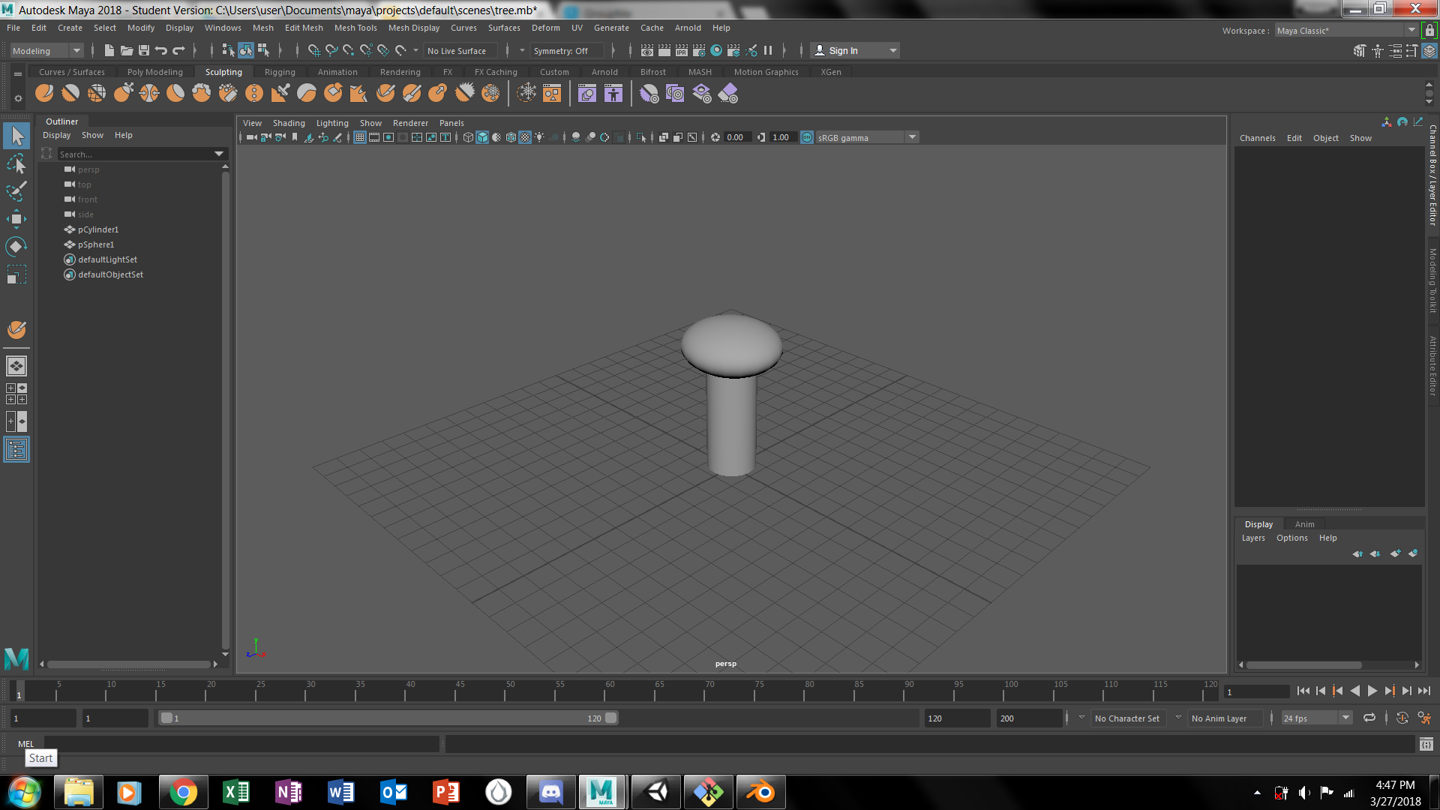
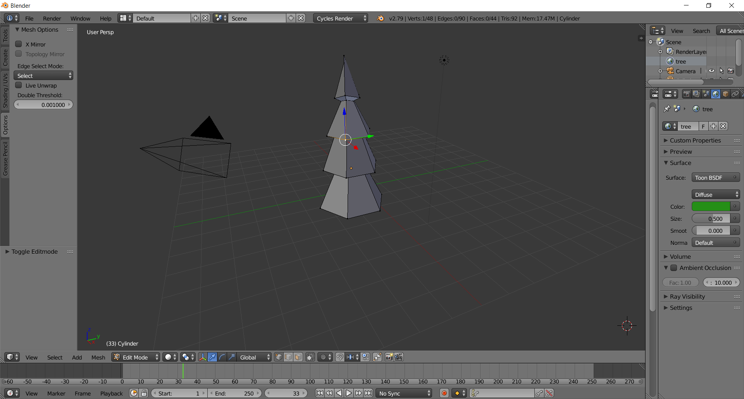
Progress so far
GPS location scripts have been found and are being implemented in a test project.
Actual project has been created and title screen is set up.
Art assets have begun being created
Just a modest tree #programmerArt

Slide 31
Planned Park Maps/Bases
Four basic types of parks:
Parks centered around rivers
Ex. - Patapsco State Park
Parks centered around Mountains
Ex. - Rocky Mountain National Park
Parks centered around forests
Ex. - literally every park
Parks centered around beaches/lakes/large bodies of water
Ex. - Sandy Point State Park

Slide 32
Animals in Parks
Theory - National and State Parks have different ecosystems and life that inhabit them. Because of this, different animals will be available at certain parks based on each park’s basic ecosystem.
Forest parks
Abundance of squirrels, chipmunks, deer, moose, elk, and things of the like
Mountain parks
Things like mountain goats, mountain lions, and other mountain critters
Plains
Bison, prairie dogs, and other things of the like
Large body of water
Abundance of fish, crabs, lobsters, and birds
River
Crawfish, shrimp, Beavers, and the platypus

Slide 33

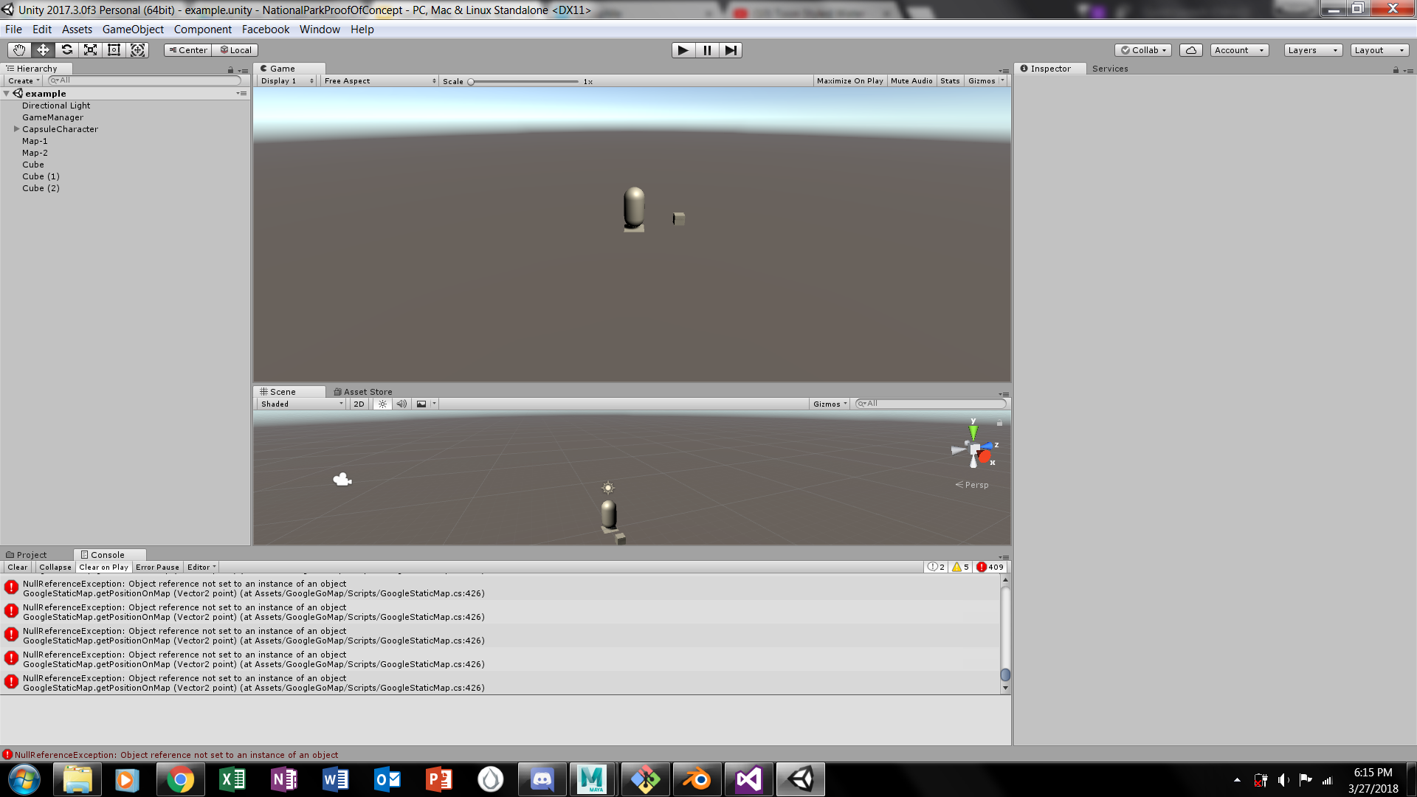
Issues Encountered During Dev
GPS scripts gotten from Unity Asset store currently do not work
Number of console errors when project runs
Art
C# - Since all of our members know Java, C# will take time to get used to. More specifically with Unity’s API in C#
Number of errors in console that break the C# code when the GPS Trial scene is played.
Demo Scene for GPS trial

Slide 34
Possible Workarounds
GPS Issue
If not able to solve issue within next few weeks, we will center the mechanics around the QR codes that would theoretically be in place around National and State Parks
QR codes would unlock different animals that are available based on what the code specifically says
Animals could then be captured in a “Safari Zone” like area where the user can choose their map based on what kind of animals they wish to catch.
They would, however, be limited to the park types that they have gone to and scanned a QR code for
C# - no workaround, but there are plenty of videos and assets that can be watched and downloaded, respectively, for free

Slide 35
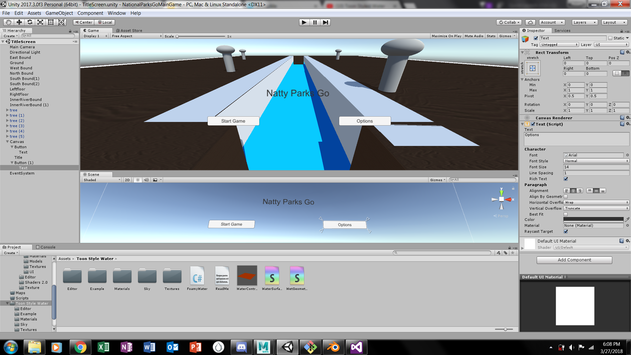
Game Pictures
Title Screen ->
Don’t mind the weird colors, fix is coming in update

Slide 36
Conclusion
Currently, we have a working website with the following features:
Hosted on Amazon Web Services with a server hosted on EC2 instance
Other information is stored on a ElasticSearch cluster and the site is secured with the necessary certificates
Next Steps:
Incorporate payment processing for the donation system, finish an interactive game, and integrate the website with social media (Facebook, Instagram, etc.)
Set up an “Create an Account” web page for future users
Decide on a homepage and complete the necessary links

Slide 37
Works Cited (This is just for the picture)
Java Picture on slide 31: https://www.pinterest.com/pin/307511480787023504/?autologin=true

